Slide 1
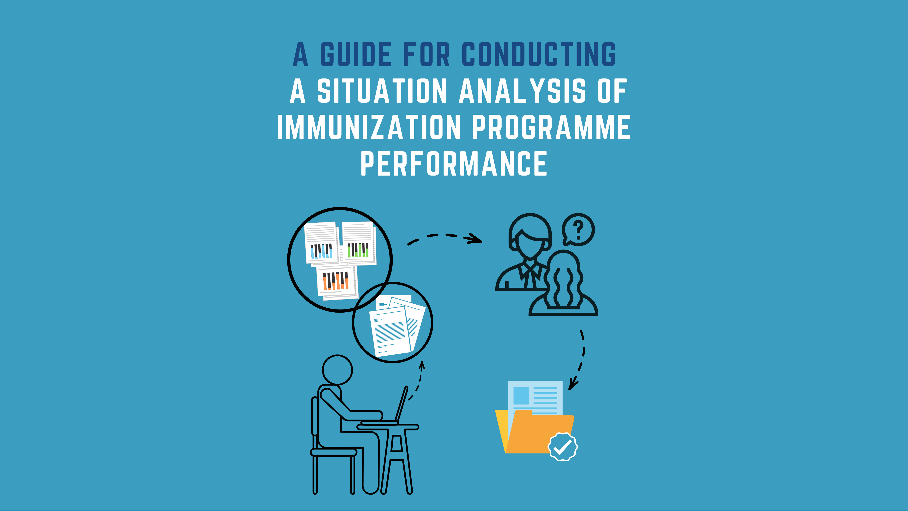
AFRO Webinar
23 February 2023

Slide 2
Links to the guidance and workbook
English: https://www.who.int/publications/m/item/guide-and-workbook-for-conducting-a-situation-analysis-of-immunization-programme-performance
French: https://www.who.int/fr/publications/m/item/guide-and-workbook-for-conducting-a-situation-analysis-of-immunization-programme-performance
Portuguese: coming soon (check the first link mid-March)

Slide 3
Agenda
Time | Topic | Presenter
5 min | • Technical Orientation | TechNet-21 Team
5 min | • Welcome remarks | WHO
10 min | • Introduction to the Situation Analysis and why it is useful | Jose Biey
15 min | • Overview of steps of the review and use-cases | Dijana Spasenoska
5 min | • Programme reviews and Recovery | Samir Sodha
10 min | • Country experience: Liberia in the context of EPI Review | Adolphus Clarke
10 min | • Country experience: Togo in the context of NIS | Robert Adjeoda
10 min | • Country experience: Cote d’Ivoire in the context of NIS | Diabete Tiyaou
20 min | • Questions and Answers | All participants

Slide 4
Welcome remarks

Slide 5
Agenda
Time | Topic | Presenter
5 min | • Technical Orientation | TechNet-21 Team
5 min | • Welcome remarks | WHO
10 min | • Introduction to the Situation Analysis and why it is useful | Jose Biey
15 min | • Overview of steps of the review and use-cases | Dijana Spasenoska
5 min | • Programme reviews and Recovery | Samir Sodha
10 min | • Country experience: Liberia in the context of EPI Review | Adolphus Clarke
10 min | • Country experience: Togo in the context of NIS
10 min | • Country experience: Cote d’Ivoire in the context of NIS | Diabete Tiyaou
20 min | • Questions and Answers | All participants

Slide 6
What is a situation analysis?
Fundamental step and key instrument in development of programme review and strategic planning (e.g. EPI Review or NIS)
Provides a thorough, comprehensive and objective assessment aimed at evaluating the national immunization programme in order to define future priorities
Quality situation analysis
  Combines a desk review with stakeholder discussions for prioritisation (potentially low cost)
  Reflects country context and draws attention to the most needed areas
  Systematic, logical, and rigorous in the analysis and conclusions
  Uses both quantitative and qualitative evidence
  Identifies critical programme barriers and assigns them relative importance

Slide 7
Systematic approach to conducting a situation analysis
Situation analysis is NOT an additional activity, but is already recommended as first step for multiple activities: EPI Review, National Immunisation Strategy (NIS), decision-making, etc.
Guidance for Conducting a Situation Analysis of Immunization Programme Performance enables national immunization programmes to use existing information sources to
  Identify critical programme barriers and assign them relative importance
  Identify any evidence gaps which must be addressed to support programme improvements
  Highlight programme successes

Slide 8
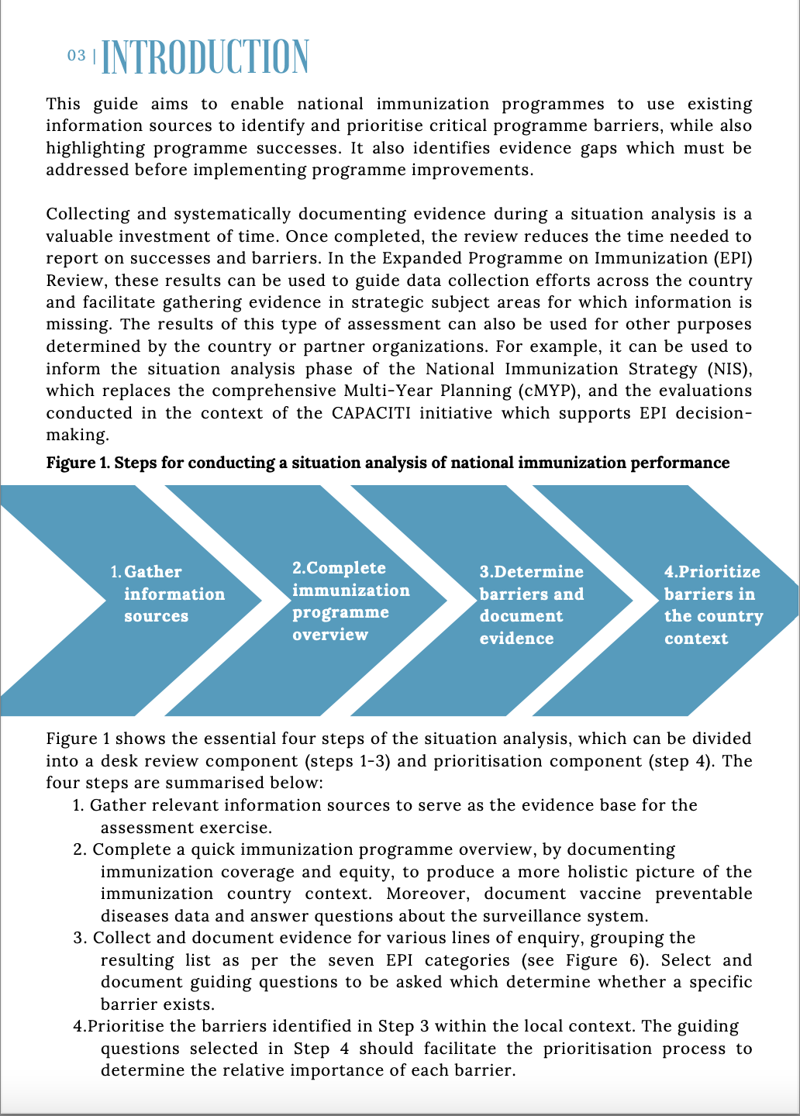
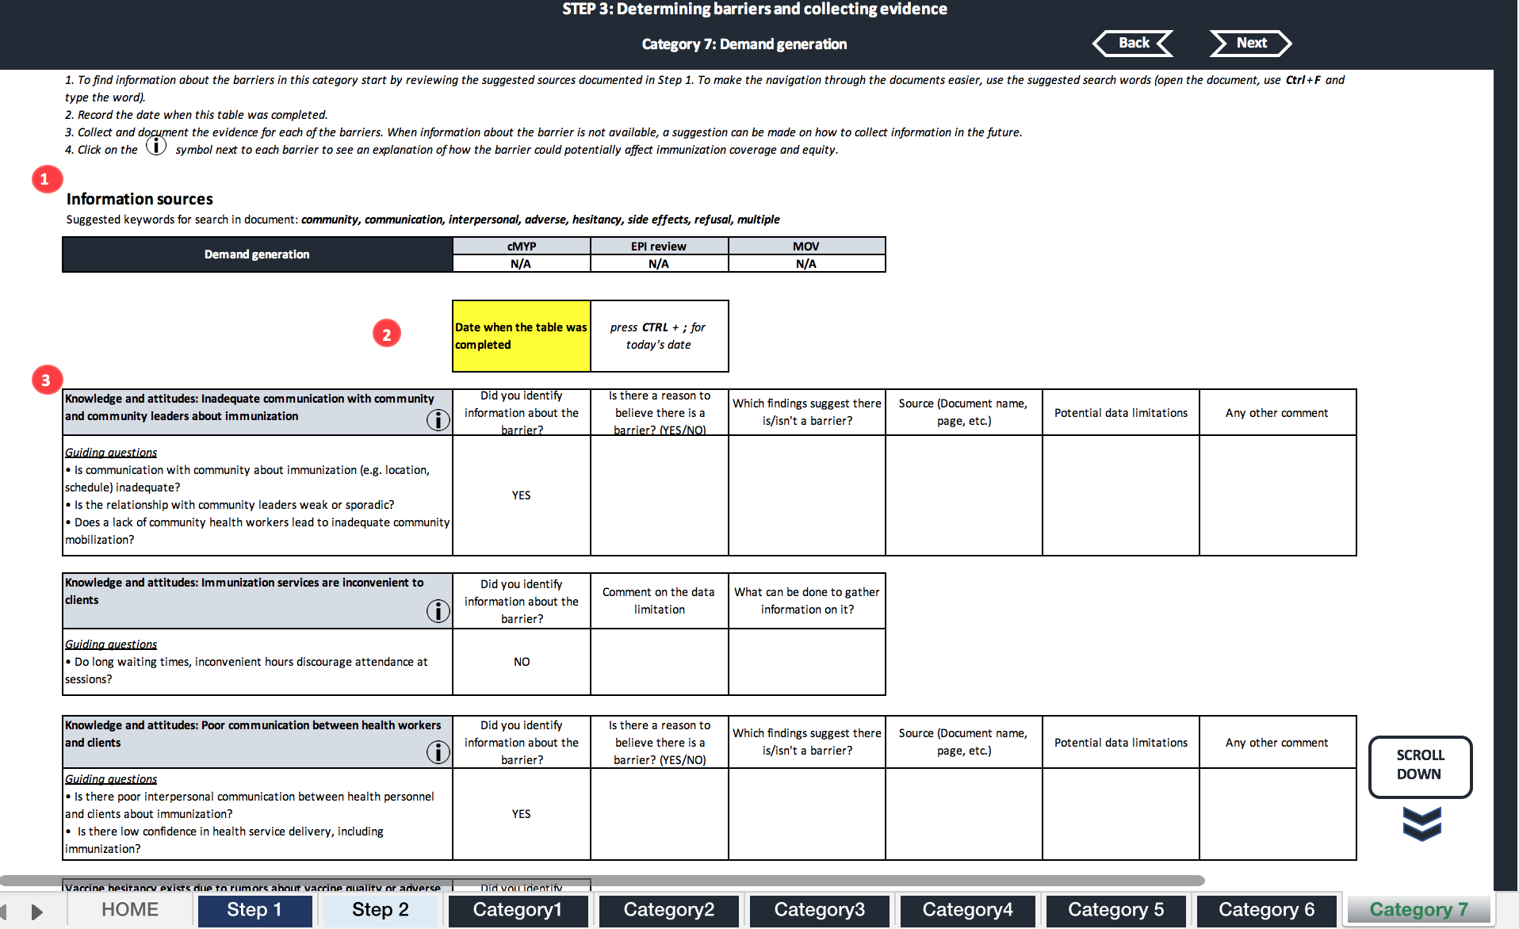
Guidance and Workbook Available
Short guidance document
Detailed Excel-based workbook offering step-by-step guidance

Slide 9
Agenda
Time | Topic | Presenter
5 min | • Technical Orientation | TechNet-21 Team
5 min | • Welcome remarks | WHO
10 min | • Introduction to the Situation Analysis and why it is useful | Jose Biey
15 min | • Overview of steps of the review and use-cases | Dijana Spasenoska
5 min | • Programme reviews and Recovery | Samir Sodha
10 min | • Country experience: Liberia in the context of EPI Review | Adolphus Clarke
10 min | • Country experience: Togo in the context of NIS | Robert Adjeoda
10 min | • Country experience: Cote d’Ivoire in the context of NIS | Diabete Tiyaou
20 min | • Questions and Answers | All participants

Slide 10
Iterative development process
Initial consultations 2019-2020 | Alignment with new priorities 2020-present | Use-cases* 2019- present
• Feedback from WHO HQ IVB staff • Meetings with partners (e.g. Gavi, UNICEF, CDC) • Immunization in Practices Advisory Committee • AFRO EPI Managers meeting • AFRO IST-West consultation • AFRO NITAG consultation • CAPACITI Steering Committee | • Immunization Agenda 2030 • Why gender matters? • Zero-dose agenda • Behavioural and Social Drivers of Vaccination (BeSD) tools • Catch-up and recovery | • Indonesia (2019) • Zambia (2020) • Liberia (2020) • Madagascar (2021) • Ethiopia (2022) • Togo (2022) • Côte d’Ivoire (2023) *Various contexts: EPI Review, NIS, CAPACITI

Slide 11




Steps of the review
1
2
3
4
Gather information
sources
Immunization programme overview
Identify barriers and document evidence
Prioritize the barriers
Key concepts:
The situation analysis does not involve primary data collection
It is country-led and uses country-specific data
Can serve as a living document- reduces country burden, only new information is added

Slide 12
Steps of the review
1
2
3
4
Systematic and thorough desk review
Multistakeholder discussion
Gather information
sources
Immunization programme overview
Identify barriers and document evidence
Prioritize the barriers
Key concepts:
The situation analysis does not involve primary data collection
It is country-led and uses country-specific data
Can serve as a living document- reduces country burden, only new information is added

Slide 13
Steps of the review
1
2
3
4
Gather information
sources
Immunization programme overview
Identify barriers and document evidence
Prioritize the barriers
Key concepts:
The situation analysis does not involve primary data collection
It is country-led and uses country-specific data
Can serve as a living document- reduces country burden, only new information is added

Slide 14

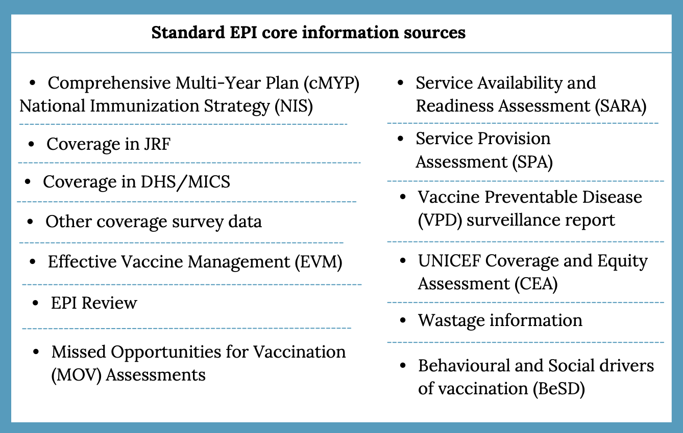
Step 1: Gather information sources
(Systematic desk review)
Gather and review relevant existing information sources
Evidence base for this assessment exercise
Recommendations of information sources, but not limiting

Slide 15

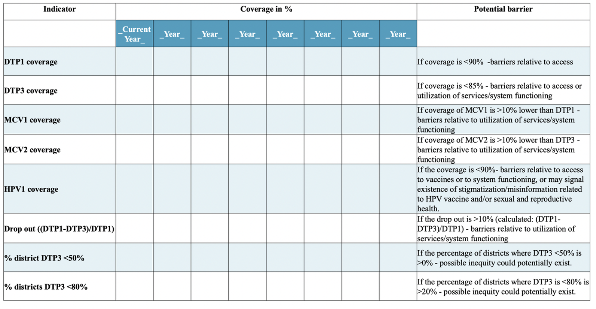
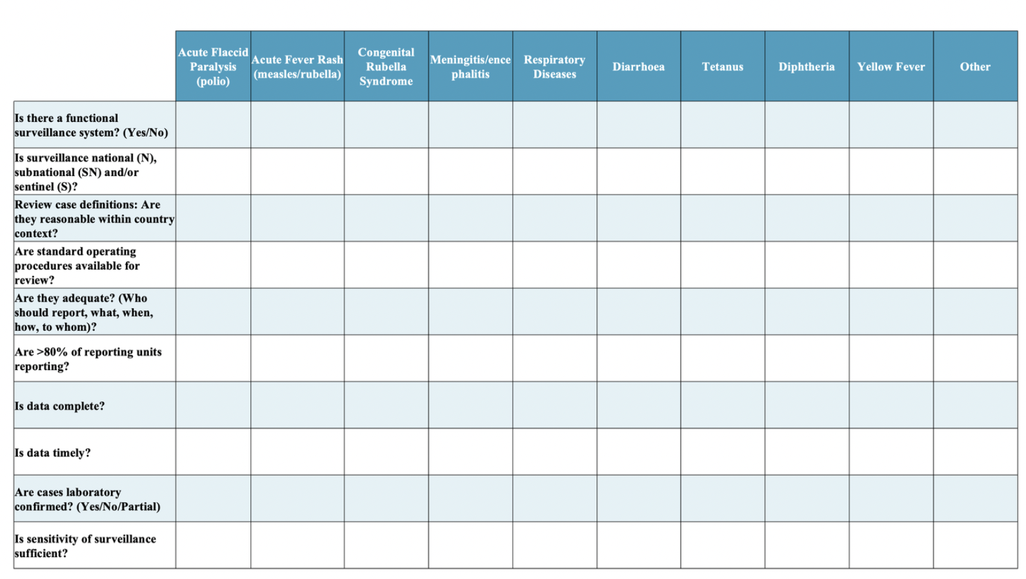
Step 2: Complete immunization programme overview (Systematic desk review)
Example of guidance
Insight into the country’s current situation for coverage and equity
Signals potential barriers in certain areas

Slide 16

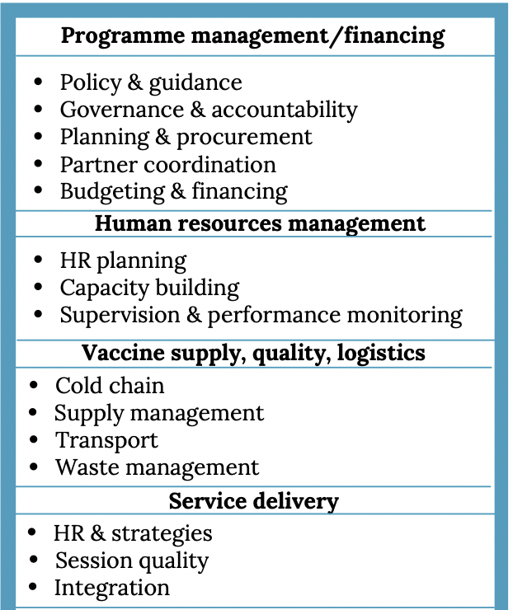
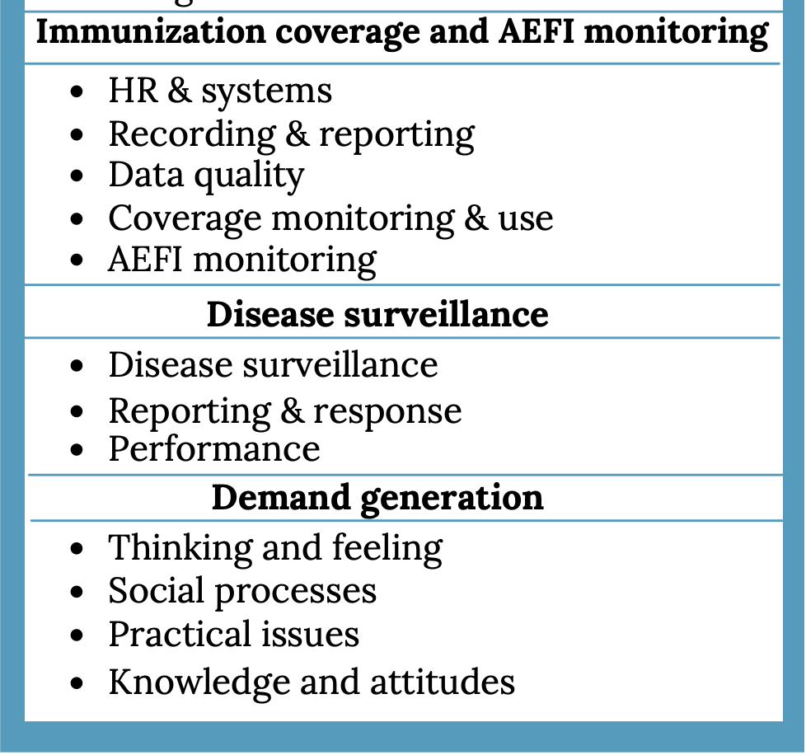
Step 3: Identify barriers and document evidence
(Systematic desk review)
Lines of enquiry grouped in the same 7 EPI Categories used for EPI Review and NIS
Extract relevant information from the sources identified in Step 1
Determine barriers, gaps and strengths based on available evidence
Systematically document both qualitative and quantitative findings

Slide 17
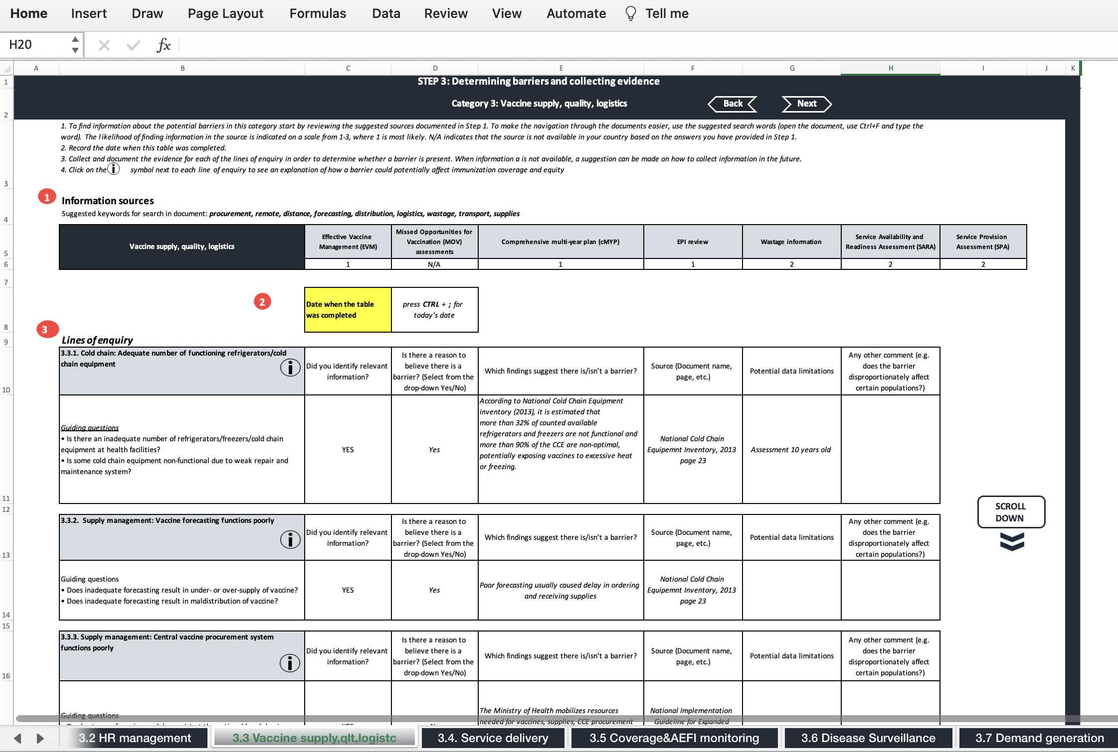
Step 3: Examples of used evidence

Slide 18
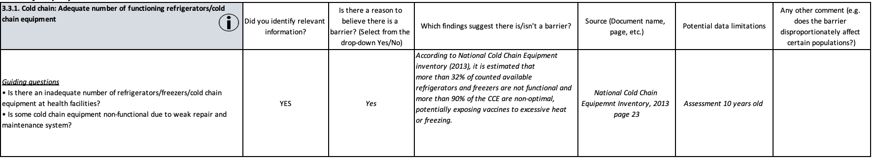
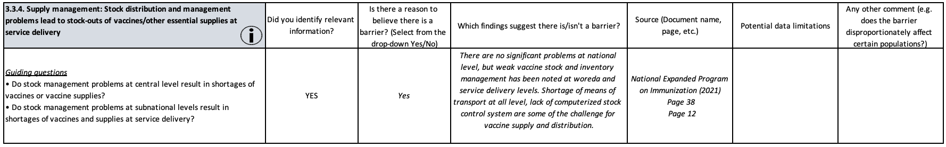
Step 3: Examples of used evidence
Quantitative evidence
Qualitative evidence

Slide 19

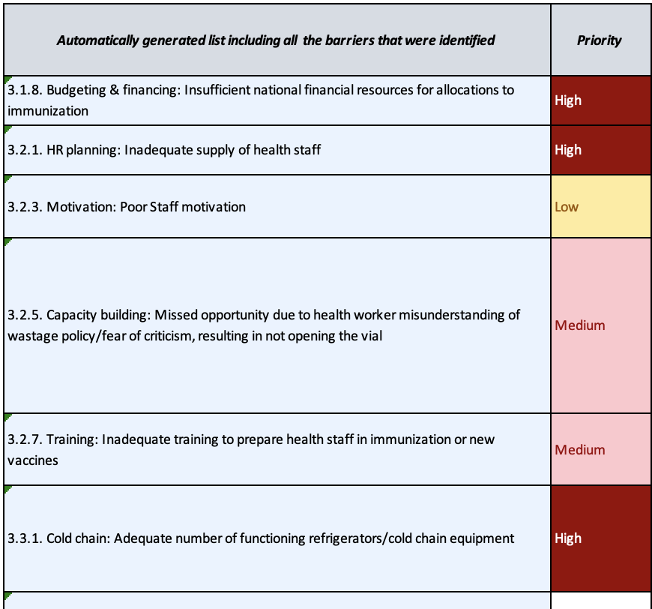
Step 4: Prioritization of identified barriers
(Multistakeholder discussion)
For illustrative purposes only
Prioritize the barriers in the given national context, based on their relative importance
Deliberation based process
List of questions available to guide the discussion

Slide 20
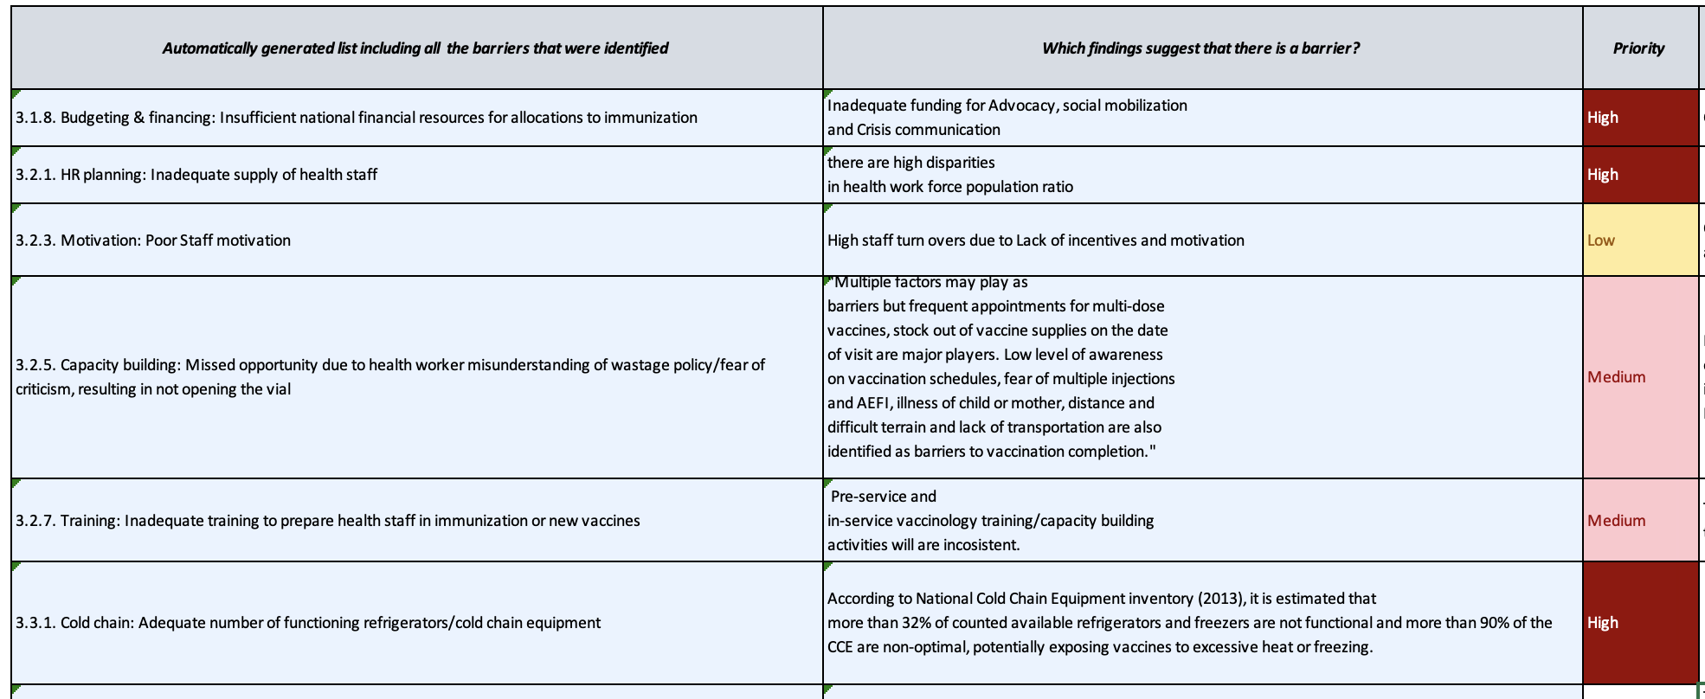
Step 4: Prioritization example

Slide 21




May help identify additional priorities
Research gaps
Programme strengths
Priority actions
Upcoming decision-making questions

Slide 22
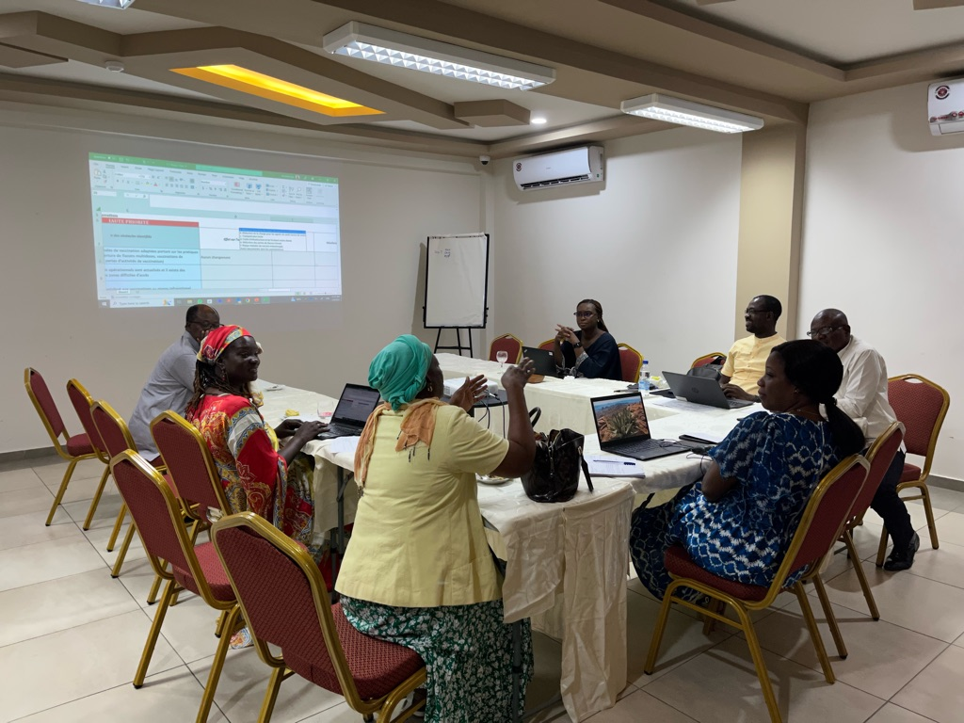
Country-led: Feedback
Workbook and guidance are very user friendly
Workshops encourage dialogue between actors that do not interact regularly
Can be used in many different contexts
Built-in flexibility for country input

Slide 23
Country-led- Selecting the appropriate format
Select context of use
Select process to do review
Select timeline

Slide 24
Country-led- Selecting the appropriate format
Select context of use
  Desk review for EPI Review: Liberia and Madagascar
  Decision-making (CAPACITI): Indonesia, Zambia, Ethiopia
  NIS: Côte d’Ivoire and Togo
  Other use-cases (e.g. mini-EPI Review for Recovery, PIE)

Slide 25
Country-led- Selecting the appropriate format
Select process to do review
  Multi-stakeholder discussion: desk review and stakeholder discussion completed by various stakeholders from NITAG, MoH, WHO and UNICEF CO, academia, etc
    Several days
    Encourages dialogue between different actors
  Mix: evidence collection can be completed by one person (desk review), and prioritization completed during a multi-stakeholders discussions
    Person with extensive immunization programme knowledge completes desk review (8-10 days)
    Prioritisation deliberated during workshop attended by various actors

Slide 26
Comparison of different approaches
 | Workshop only | Independent reviewer only
Conducting the assessment | 2 days workshop to complete the review; Various participants from NITAG, MoH, WHO and UNICEF CO, Academia etc. | 8-10 days to complete the review. One independent reviewer working remotely that is familiar with the immunization programme.
Findings comparison | ~80% concordance with identifying barriers
 | Not much concordance with prioritization

Slide 27
Country-led- Selecting the appropriate format
Select timeline
 | Week 1 |  | Week 2 | Week 3 |  | Week 4
Teleconference support from HQ
Gathering information sources
Completing the workbook
Writing up and feedback
Multistakeholder discussion
* If the information sources are readily available in one database then it will take less than a week to complete the first step
** Depends on the person conducting the review, the time can be reduced to 8-10 days maximum
*** We can provide technical support on using the tool, and answer any questions on the guidance via teleconferences

Slide 28
Agenda
Time | Topic | Presenter
5 min | • Technical Orientation | TechNet-21 Team
5 min | • Welcome remarks | WHO
10 min | • Introduction to the Situation Analysis and why it is useful | Jose Biey
15 min | • Overview of steps of the review and use-cases | Dijana Spasenoska
5 min | • Programme reviews and Recovery | Samir Sodha
10 min | • Country experience: Liberia in the context of EPI Review | Adolphus Clarke
10 min | • Country experience: Togo in the context of NIS | Robert Adjeoda
10 min | • Country experience: Cote d’Ivoire in the context of NIS | Diabete Tiyaou
20 min | • Questions and Answers | All participants

Slide 29
25 million children were un-or under-vaccinated in 2021, 2 million more than in 2020, and 6 million more than in 2019
Coverage of the third dose of diphtheria, tetanus, and pertussis vaccine (DTP-3) dropped a further 2% compared 2020, to 81% in 2021, leaving 25 million children vulnerable to vaccine-preventable diseases​
The Immunization Agenda 2030 aims to make vaccination available to everyone, everywhere, by 2030. The Covid-19 pandemic, associated disruptions, and Covid-19 vaccination efforts have strained health systems in 2020 and 2021, resulting in 25 million children missing out on vaccination, 6 million more than in 2019 and the highest number since 2008. The number of children missing out on any vaccination - “zero-dose children” – increased by 5 million in 2021 compared with 2019, going from 13 to 18 million.
In this analysis, zero-dose children are those who lack any dose of DTP. Under-vaccinated are those who received one dose, but not a third protective dose.

Slide 30
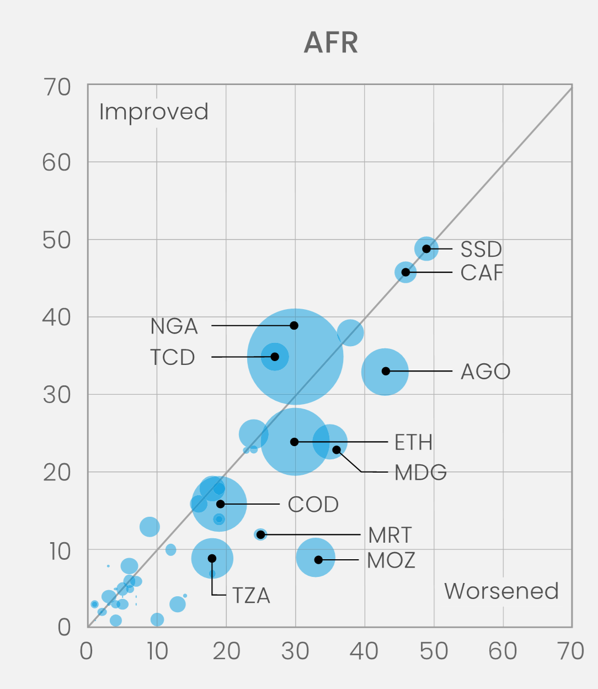
Compared with 2019, the number of zero-dose children increased sharply in the African region during the pandemic (2019 vs. 2021)
The number of zero-dose children – those never vaccinated with even a first dose of DTP-containing vaccine, increased by 17%, from 6.6 to 7.7 million.
7.7 million children were left out by immunization services in 2021. Almost all zero-dose children live in low- and middle-income countries
In this analysis, zero-dose children are those who lack any dose of DTP. Under-vaccinated are those who received one dose, but not a third protective dose.
2019 zero dose prevalence (%)
2021 zero dose prevalence (%)

Slide 31






Proposed 3-prong approach:
Delivered through:
1
Catch-up
Political leadership
Reaching 35.7 million children from past cohorts of zero-doze children that accumulated during the pandemic (2019 to 2022).
Advocacy and partnerships
2
Restore immunization programmes
Resource mapping
Increasing coverage and returning to the trajectory towards reaching IA2030 goals
Tailored country response planning and implementation
3
Strengthen immunization programmes to sustainably reach zero-dose children through PHC and community systems
Responsive technical assistance
Investing in systems strengthening and innovation to accelerate progress to IA2030 targets.
Monitoring and learning

Slide 32
Catch up and Recovery
Catch-up and recovery strategies and plans should be based on evidence from program reviews
Comprehensive EPI review
  Gold standard
  Not done in most countries in recent years because of COVID-19 pandemic
  Difficult to do on short notice (cost, time consuming, labor intensive)
Situation analysis of immunization programme performance
  Ideally should serve as initial desk review of EPI review and NIS
  May serve as “mini-EPI review” when comprehensive EPI review not feasible
    Systematic review of programme
    Lower cost
    Approximately one month needed
    Not labor intensive

Slide 33
Agenda
Time | Topic | Presenter
5 min | • Technical Orientation | TechNet-21 Team
5 min | • Welcome remarks | WHO
10 min | • Introduction to the Situation Analysis and why it is useful | Jose Biey
15 min | • Overview of steps of the review and use-cases | Dijana Spasenoska
5 min | • Programme reviews and Recovery | Samir Sodha
10 min | • Country experience: Liberia in the context of EPI Review | Adolphus Clarke
10 min | • Country experience: Togo in the context of NIS | Robert Adjeoda
10 min | • Country experience: Cote d’Ivoire in the context of NIS | Diabete Tiyaou
20 min | • Questions and Answers | All participants

Slide 34
Country example: Liberia
How did you use the tool?
  Purpose
  Users
  Timeline
What were the strengths of this methodology?
What are some lessons you want to share with participants?
Would you recommend this guidance to other countries?

Slide 35
Agenda
Time | Topic | Presenter
5 min | • Technical Orientation | TechNet-21 Team
5 min | • Welcome remarks | WHO
10 min | • Introduction to the Situation Analysis and why it is useful | Jose Biey
15 min | • Overview of steps of the review and use-cases | Dijana Spasenoska
5 min | • Programme reviews and Recovery | Samir Sodha
10 min | • Country experience: Liberia in the context of EPI Review | Adolphus Clarke
10 min | • Country experience: Togo in the context of NIS | Robert Adjeoda
10 min | • Country experience: Cote d’Ivoire in the context of NIS | Diabete Tiyaou
20 min | • Questions and Answers | All participants

Slide 36
Country example: Togo
How did you use the tool?
  Purpose
  Disposer d’une analyse de la situation :
    Complète et systématique
    Basée sur les données factuelles (rapports, documents) disponibles sur le PEV du Togo et non pas sur des opinions personnelles
  Faciliter l’élaboration de la Stratégie Nationale de Vaccination
  Faciliter les discussions dans les travaux de groupe

Slide 37
Country example: Togo
How did you use the tool?
  Users
  Consultant : maîtriser l’outil pour orienter les autres parties prenantes sur son utilisation
  Participants à l’atelier d’analyse de la situation : chacun des 07 groupes thématiques a utilisé l’outil
  Timeline
  Utilisé
    Lors de l’atelier préparatoire à l’analyse de la situation (06 au 08 septembre 2022)
    Lors de l’atelier d’analyse de la situation (12 au 16 septembre 2022)
    Pour la hiérarchisation des obstacles à l’atteinte des objectifs de couverture (25 au 29 octobre 2022)

Slide 38
Country example: Togo
• What were the strengths of this methodology?
    Questions principales et questions d’orientations dans l’outil facilitent la réflexion dans les travaux de groupes
    Basée sur les 7 principaux domaines pertinents du PEV :
    1- Gestion du programme et financement;
    2 - Ressources Humaines;
    3- Approvisionnement et logistique de qualité;
    4- Prestation de service;
    5- Couverture et MAPI;
    6- Surveillance et Système d’information;
    7- Génération de la demande
    Simple d’utilisation si l’outil est bien maîtrisé
    Permet de générer et classer automatiquement dans des feuilles séparées les points forts, obstacles et domaines possibles de recherche et d’apprentissage
    Facilite la hiérarchisation des priorités identifiées

Slide 39
Country example: Togo
What are some lessons you want to share with participants?
Nécessité d’une bonne maîtrise de l’outil
Importance de l’appui technique de l’OMS/IST pour orienter sur certains aspects
Disposer de la dernière version avec prise en compte des aspects liés au genre
Avoir à disposition tous les documents nécessaires : il y a une liste des documents susceptibles d’être utilisés dans l’outil
Disposer dans l’idéal des données récentes sur le PEV
Avant l’atelier national d’analyse de la situation: Briefer les principaux membres des 07 groupes thématiques sur les différentes parties de l’outil avant l’atelier pour faciliter la compréhension des autres participants
Briefer les participants à l’atelier sur les différentes parties de l’outil et ses objectifs
Pour la partie « Hiérarchisation », il est important d’utiliser les critères énumérés dans l’outil pour réaliser la notation de chaque obstacle, ceci facilite la priorisation
Bien préparer l’atelier d’analyse de la situation car les 5 jours que le Togo a utilisé a semblé insuffisant

Slide 40
Country example: Togo
Would you recommend this guidance to other countries?
Recommandation d’utilisation de l’outil car :
  Permet de systématiser l’analyse de la situation du PEV
  Les questions principales et questions d’orientations facilitent la réflexion dans les travaux de groupes
  Les obstacles sont générés automatiquement après renseignement de l’outil
  La partie hiérarchisation des obstacles est disponible dans l’outil et facilite les analyses
  Conclusion : Nous recommandons vivement l’utilisation de cet outil aux autres pays qui sont dans le processus d’élaboration du NIS car il est pratique.

Slide 41
Agenda
Time | Topic | Presenter
5 min | • Technical Orientation | TechNet-21 Team
5 min | • Welcome remarks | WHO
10 min | • Introduction to the Situation Analysis and why it is useful | Jose Biey
15 min | • Overview of steps of the review and use-cases | Dijana Spasenoska
5 min | • Programme reviews and Recovery | Samir Sodha
10 min | • Country experience: Liberia in the context of EPI Review | Adolphus Clarke
10 min | • Country experience: Togo in the context of NIS | Robert Adjeoda
10 min | • Country experience: Cote d’Ivoire in the context of NIS | Diabete Tiyaou
20 min | • Questions and Answers | All participants

Slide 42
Country example: Côte d’Ivoire
  But:
  Le but de cette analyse était de déterminer la situation actuelle de la vaccination et d’en tenir compte pour les orientations futures pour la prise de décision sur le PEV et surtout pour l'adoption de projet d’une chaîne de température contrôlée (CTC),
  Les recommandations issues de cette analyse faites via le outil d'analyse de situation du programme de vaccination a permis d'identifier les lacunes dans le programme de vaccination en vue d’apporter les améliorations requises.
  Les résultats peuvent aussi être utilisés pour le développement des stratégies nationales de vaccination (SNV) ou pour éclairer les évaluations à mener dans le cadre de l'initiative CAPACITI qui soutient la prise de décision par le PEV.

Slide 43
Country example: Côte d’Ivoire
Comment avez-vous utilisé l'outil ?
  Pour exploiter l’outil nous avons identifier et collecter les ressources documentaires suivantes: PPAC 2016-2020, Rapports revue PEV 2021, Rapport ENCV, GEV 2021, EDS 2021
  Procéder à la Revue des documents sus cités à travers la fonctionnalité recherche des mot clés
Utilisateurs: Consultant national pour la budgétisation du mis
Calendrier
  L’analyse a été réalisée du 27 janvier au 7 février 2023
  C’était en quelques sorte une reprise de l’exercice d’analyse de situation qui avait été réalisée dans le cadre de l’élaboration du NIS 2022-2025.

Slide 44
Country example: Côte d’Ivoire
• Quels étaient les points forts de cette méthodologie ?
  La disponibilité des ressources documentaires ;
  La disponibilité des RH du PEV pour d’éventuels compléments d’information;
  Structure (Présentation) de l’outil qui tienne en compte toutes les composantes de la vaccination;
  Existence de quelques questions d’orientations qui facilitent la compréhension des principales questions posées;

Slide 45
Country example: Côte d’Ivoire
Quelles sont les leçons apprise que vous souhaitez partager avec les participants?
  Faire une bonne étape préparatoire: administrative, ressources
  Impliquer toutes les parties prenantes
  Organiser une séance de coaching (en ligne ou en présentiel) pour s’assurer de la bonne compréhension des différents items ou questions
  Faire la triangulation des données issues des différentes sources
  Veiller à la disponibilité de tout document jugé utile
  Montrer l’ampleur du problème à travers des évidences (données probantes)
  Discuter les conclusions de l’analyse de la situation avec les parties prenantes
Recommanderiez-vous ce guide à d'autres pays?
  Oui, nous recommandons fortement cet outil à un pays qui amorce le processus de développement de la SNV

Slide 46
Thank you
  For any questions you can email Dijana Spasenoska (spasenoskad@who.int) or Samir Sodha (sodhas@who.int)
  We appreciate your feedback, at the end please complete our feedback form here.
Special thanks to Anna-Lea Kahn, Margie Watkins, the pilot countries’ teams, and all colleagues from HQ, Regional and Country Offices that have provided feedback.

Slide 47
Agenda
Time | Topic | Presenter
5 min | • Technical Orientation | TechNet-21 Team
5 min | • Welcome remarks | WHO
10 min | • Introduction to the Situation Analysis and why it is useful | Jose Biey
15 min | • Overview of steps of the review and use-cases | Dijana Spasenoska
5 min | • Programme reviews and Recovery | Samir Sodha
10 min | • Country experience: Liberia in the context of EPI Review | Adolphus Clarke
10 min | • Country experience: Togo in the context of NIS | Robert Adjeoda
10 min | • Country experience: Cote d’Ivoire in the context of NIS | Diabete Tiyaou
20 min | • Questions and Answers | All participants

Slide 48
Links to the guidance and workbook
English: https://www.who.int/publications/m/item/guide-and-workbook-for-conducting-a-situation-analysis-of-immunization-programme-performance
French: https://www.who.int/fr/publications/m/item/guide-and-workbook-for-conducting-a-situation-analysis-of-immunization-programme-performance
Portuguese: coming soon (check the first link mid-March)

